Slide 1
Inheritance
This is your parents' class

Slide 2
Objectives
Learn about the concept of inheritance
Extend classes
Override superclass methods
Call constructors during inheritance
Access superclass methods
Employ information hiding
Learn which methods you cannot override

Slide 3
Learning About the Concept of Inheritance
Inheritance
A mechanism that enables one class to inherit both the behavior and the attributes of another class
Apply your knowledge of a general category to more specific objects

Slide 4
What is UML?
Unified Modeling Language (UML)
Consists of many types of diagrams
Class diagram
A visual tool
Provides an overview of a class

Slide 5
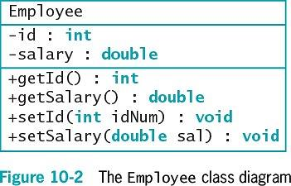
Class UML

Slide 6
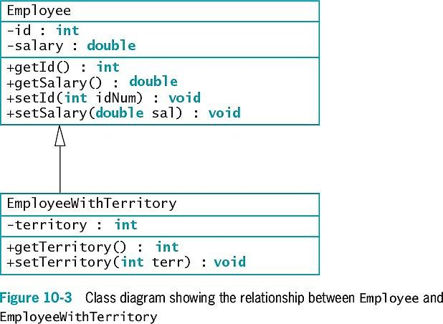
Super and Sub classes

Slide 7
Why Inheritance?
Use inheritance to create a derived class
Saves time
Reduces errors
Reduces the amount of new learning required to use a new class

Slide 8
Base Class
Base class
Used as a basis for inheritance
Also called:
Superclass
Parent class

Slide 9
Derived Class
Derived class
Inherits from a base class
Always "is a" case or an example of a more general base class
Poodle is a Dog, but Dog is not always a Poodle
Also called:
Subclass
Child class

Slide 10
Extending Classes
Keyword extends
Used to achieve inheritance in Java
Example:
public class EmployeeWithTerritory extends Employee
Inheritance is a one-way proposition
A child inherits from a parent, not the other way around
Subclasses are more specific
instanceof operator to test

Slide 11
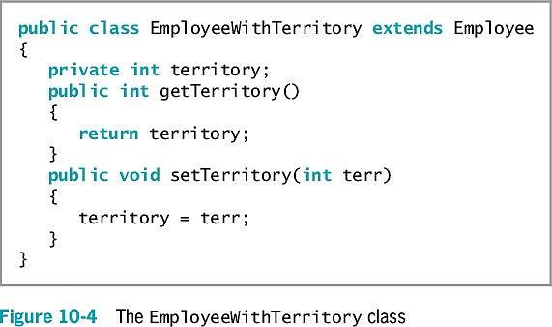
In Action

Slide 12
Overriding Superclass Methods
Create a subclass by extending an existing class
A subclass contains data and methods defined in the original superclass
Sometimes superclass data fields and methods are not entirely appropriate for subclass objects
Polymorphism
The same method name is used to indicate different implementations

Slide 13
Rules for Override
Override the method in the parent class
Create a method in a child class that has the same name and parameter list as a method in its parent class
Subtype polymorphism
The ability of one method name to work appropriately for different subclass objects of the same parent class
Override annotation (@Override)
Tells compiler you are overriding a parent class method
Make sure to do this!

Slide 14
Calling Constructors During Inheritance
When you instantiate an object that is a member of a subclass, you call at least two constructors:
The constructor for the base class
The constructor for the extended class
The superclass constructor must execute first
When the superclass contains a default constructor, the execution of the superclass constructor is transparent

Slide 15
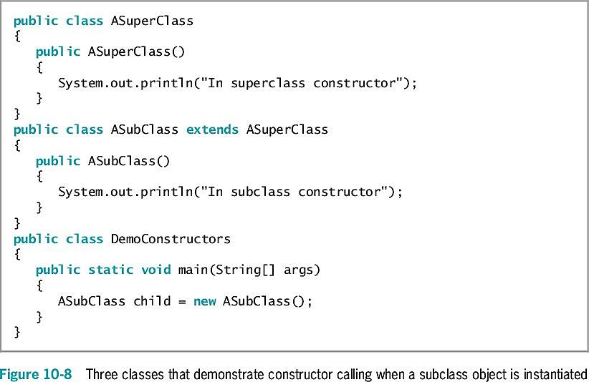
In Action

Slide 16
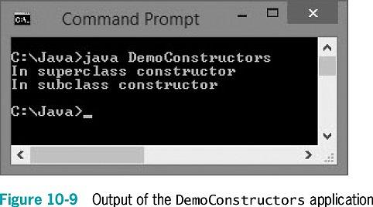
Results

Slide 17
Using Superclass Constructors That Require Arguments
When you write your own constructor
You replace the automatically supplied version
When extending a superclass with constructors that require arguments
The subclass must provide the superclass constructor with the arguments it needs

Slide 18
Default versus Required
When a superclass has a default constructor
You can create a subclass with or without its own constructor
When a superclass contains only constructors that require arguments
You must include at least one constructor for each subclass you create
The first statement within each constructor must call one of the superclass constructors

Slide 19
super!
Call the superclass constructor
super(list of arguments);
Needs to be first line
Keyword super
Always refers to the superclass

Slide 20
Accessing Superclass Methods
Use the overridden superclass method within a subclass
Use the keyword super to access the parent class method

Slide 21
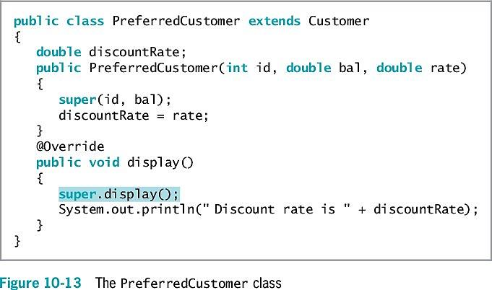
In Action

Slide 22
Comparing this and super
Think of the keyword this as the opposite of super within a subclass
When a parent class contains a method that is not overridden
The child can use the method name with super or this, or alone
If the parent class is overridden, you then need to use super!

Slide 23
Information Hiding Revisited
Within the Student class:
The keyword private precedes each data field
The keyword public precedes each method
Information hiding
The concept of keeping data private
Data can be altered only by methods you choose and only in ways that you can control

Slide 24
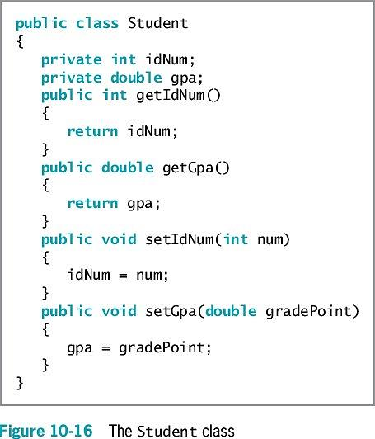
Our Student class

Slide 25
Employing Information Hiding with SuperClass
When a class serves as a superclass
Subclasses inherit all data and methods of the superclass
Except private members of the parent class are not accessible within a child class's methods

Slide 26
protected to the rescue
Keyword protected
Provides an intermediate level of security between public and private access
Can be used within its own class or in any classes extended from that class
Cannot be used by "outside" classes

Slide 27
Methods You Cannot Override
static methods
final methods
Methods within final classes

Slide 28
A Subclass Cannot Override static Methods in Its Superclass
A subclass cannot override methods declared static in the superclass
A subclass can hide a static method in the superclass by declaring a static method with the same signature as the static method in the superclass
Then call the new static method from within the subclass or in another class by using a subclass object
Within the static method of a subclass, you cannot access the parent method using the super object

Slide 29
Child class can use parent's static
Although a child class cannot inherit its parent's static methods, it can access its parent's static methods in the same way any other class can

Slide 30
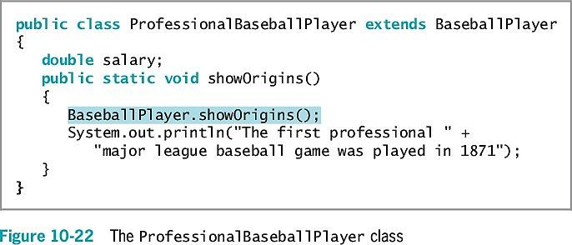
In Action

Slide 31
A Subclass Cannot Override final Methods in Its Superclass
A subclass cannot override methods declared final in the superclass
final modifier
Does not allow the method to be overridden
Virtual method calls
Default in Java
The method used is determined when the program runs
The object type might not be known until the method executes

Slide 32
Why use final?
Advantages to making the method final:
The compiler knows only one version of the method exists
The compiler knows which method version will be used
A program's performance can be optimized by removing calls to final methods
Inlining the code: each method call is replaced with the expanded code of the method's definition

Slide 33
final class cannot be a parent
When a class is declared final:
All of its methods are final regardless of which access modifier precedes the method name
It cannot be a parent class

Slide 34
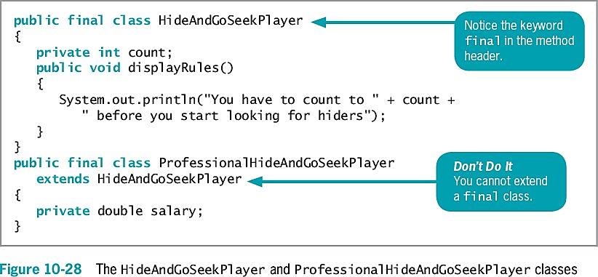
Danger!

Slide 35
You Do It
Demonstrating Inheritance
Overriding a Superclass Method
Understanding the Role of Constructors in Inheritance

Slide 36
Don't Do It
Don't capitalize the o in the instanceof operator
Don't try to directly access private superclass members from a subclass
Don't forget to call a superclass constructor from within a subclass constructor if the superclass does not contain a default constructor
Don't try to override a final method in an extended class
Don't try to extend a final class

Slide 37
Summary_0
Inheritance
A mechanism that enables one class to inherit both the behavior and the attributes of another class
Keyword extends
Used to achieve inheritance in Java
Polymorphism
The act of using the same method name to indicate different implementations

Slide 38
Summary_1
Use a superclass method within a subclass
Use the keyword super to access it
Information hiding
The concept of keeping data private
Keyword protected
Provides an intermediate level of security between public and private access
A subclass cannot override methods that are:
Declared static in a superclass
Declared final or declared within a final class

